Slide 1
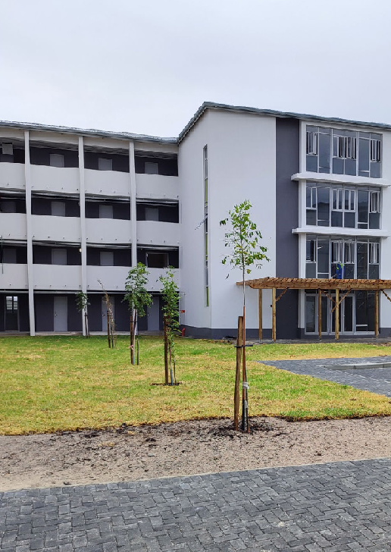

CAPE PENINSULIA UNIVERSITY OF TECHNOLOGY – PFP 362S – GROUP 8
Belhar Community Job Market Place
A trusted local platform connecting Belhar residents with nearby workers – quickly, safely, and affordably.
Connectly

Slide 2

OUR JOURNEY
From Idea to Opportunity
Initial Idea
Lacked a clear profit model
Consultation Feedback
Guided our pivot and focus
Community Job Marketplace
Practical, viable, community-driven

Slide 3

MARKETING STRATEGY - WHO
Who We Serve
Our Customer
Homeowners, parents, elderly residents, small business owners in Belhar
Customer Persona
Age 25 - 50
Income R8,000 – R30,000/month
Busy professionals needing trusted local help
Pain point: unreliable workers, lack of trust, high unemployment

Slide 4
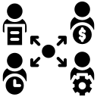


MARKETING STRATEGY - WHO
What Customers Are Really Buying
Functional Benefit
Posts jobs instantly
Workers apply immediately
Direct messaging
Emotional Benefit
Peace of mind
Community trust
Less stress finding help
Financial Benefit
Affordable vs agencies
Saves time
Workers reduce transport costs

Slide 5
MARKETING STRATEGY – WHERE & WHEN
Reaching Our Community
Where They Are
Online: WhatsApp, Instagram, Facebook, TikTok
Physical: Shopping centers, taxi ranks, schools, churches
Our 5 Channels
WhatsApp community groups
Facebook ads & pages
Instagram & TikTok content
Flyers at community hubs
When They Buy
Pay Days: 15th – 1st of month
Seasonal: Holidays, spring cleaning, school terms
Daily: Weekdays, weekends, month-end

Slide 6


MARKETING STRATEGY – WHY
Why Choose Us
Hyper-Local Focus
Built exclusively for Belhar
Direct Messaging
Safe, private communication
Community Impact
Creates real jobs for residents
Connectly

Slide 7
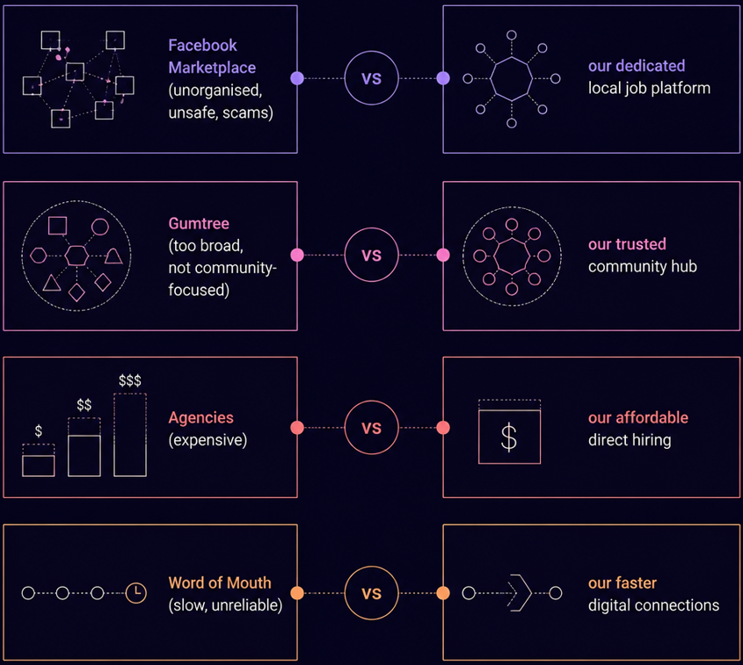
COMPETITIVE LANDSCAPE
How We Compare
Existing options fall short–too broad, too expensive, or too unreliable. Our platform fills this gap with a dedicated, trusted, local solution.

Slide 8
FEASABILITY
Startup Costs & Resources
Resources Required
Skills: App development, marketing, customer support
People: Developers, marketing team, admin
Tools: IDEs, database, social media platforms
Total Startup Cost: R14,000 - low barrier to entry

Slide 9



RISK & VIABILITY
Risks We’ve Identified
Marketing Risk
Users may stick with Facebook over downloading a new app
Financial Risk
Early-stage profitability may be slow to materialize
Operational Risk
Fake posts or dishonest employers could erode platform trust
Ultimately: High smartphone usage, strong community demand, and low startup costs make this venture viable.

Slide 10
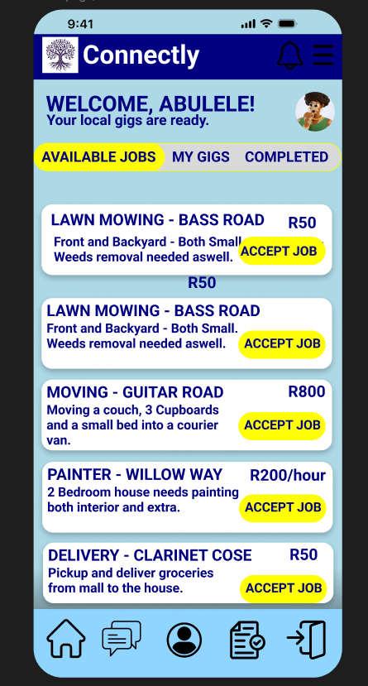
View Our Figma Prototype https://www.figma.com/design/xETbhrqF4Ou7xrWk3oIhev/PFP-Design?node-id=0-1&t=M88xVWRANfbpLcZh-1
NEXT STEPS
Our MVP Plan
1
Test Interest
WhatsApp flyers, social media pages, Google forms
2
Measure Success
10 – 25 Sign-ups ; 10 job posts; 5 – 10 worker connections
3
Build & Launch
Full app development based on validated demand

